Slide 1

Topic: My Professional Identity: CV, Resume & LinkedIn
Presented By:
Name: Md. Meahadi Hasan
ID: 0322310105101034

Slide 2
Introduce Myself
Assalamu Alaikum Everyone! I’m Meahadi Hasan, a passionate Web Developer with a strong foundation in front-end development, responsive design, and user-friendly application development. I specialize in creating visually appealing and functional websites using HTML, CSS, JavaScript.
Currently, I’m studying my B.Sc. in Computer Science & Engineering at Pundra University of Science & Technology. I’ve also completed virtual internships at CodSoft and Prodigy InfoTech, where I worked on real-world projects, including responsive web applications, weather apps, and interactive games.
I’m certified in Front-End Development by Meta, Web Development by IBM, and .NET Full Stack Development by Board Infinity.
I’m always eager to learn and grow in the field of web development, and I’m excited to contribute to innovative projects that make a difference. Let’s connect and explore opportunities to collaborate!

Slide 3
What is a CV?
📜 Curriculum Vitae (CV): A detailed document showcasing your education, work experience, achievements, and skills.
Key Features:
Length:
2–3 pages or more (no strict limit).
Content:
Full academic history (degrees, research, publications).
Detailed work experience (including internships, projects).
Certifications, awards, and professional affiliations.
Purpose:
Showcases your entire career journey and expertise.

Slide 4
What is a Resume?
📄 Resume: A concise document summarizing your skills, experience, and qualifications.
Key Features:
Length:
1–2 pages (short and to the point).
Content:
Key skills and achievements.
Work experience (focused on relevance to the job).
Education and certifications (briefly mentioned).
Purpose:
Quickly demonstrates your fit for a specific role.
Page 3

Slide 5
Importance of LinkedIn
🌐 LinkedIn:
A professional networking platform to showcase your skills and career journey.
Helps in job searching, networking, and connecting with industry experts.
Employers and recruiters use it to find potential candidates.
Allows you to share projects, articles, and achievements to build your brand.
Why LinkedIn Matters:
Professional Branding: Showcases your skills, experience, and achievements.
Networking: Connects you with industry professionals, recruiters, and mentors.
Job Search: Features job postings tailored to your profile. Allows recruiters to find and contact you directly.
Learning & Growth: Access to LinkedIn Learning for skill development. Stay updated on industry trends and news.
Page 4

Slide 6
Tools Used to Create CV & Resume
Tools Used to Create CV:
Microsoft Word:
Ideal for customizing and formatting a CV professionally.
Features: Templates, formatting tools, spell check.
Tools Used to Create Resume:
Canva
User-friendly platform with customizable templates.
Features: Drag-and-drop editor, design elements, and export options.
Microsoft PowerPoint
Used for creative and visually appealing resumes.
Features: Shapes, icons, and design flexibility.

Slide 7
LinkedIn Profile Overview
Key Sections of a Strong LinkedIn Profile:
Professional Profile Picture: A clear and high-quality image that represents my professionally.
Headline: CSE Student (Undergraduate) | HTML, CSS, JavaScript, MongoDB | Web Development | Intern at Prodigy InfoTech
About Section: As-salamu alaykum! This is Meahadi Hasan. Now I'm studying B.Sc. in Computer Science and Engineering (CSE) at Pundra University of Science & Technology.
To obtain a respectful post that I will enjoy working under with any well- known and preferable International Organization that will help enhances my abilities and qualities.
Experience Section: Web Development Intern | CodSoft | Jan 2025 - Feb 2025
Skills: HTML,CSS,JavaScript, MongoDB
Certifications: Introduction to Front-End Development Certificate by Meta,
Front End Development - HTML by Great Learning, Mongo DB Certification Course
by Programming Hub.
Projects: Java Swing BMI Calculator Project | Nov 2023 - Dec 2023

Slide 8
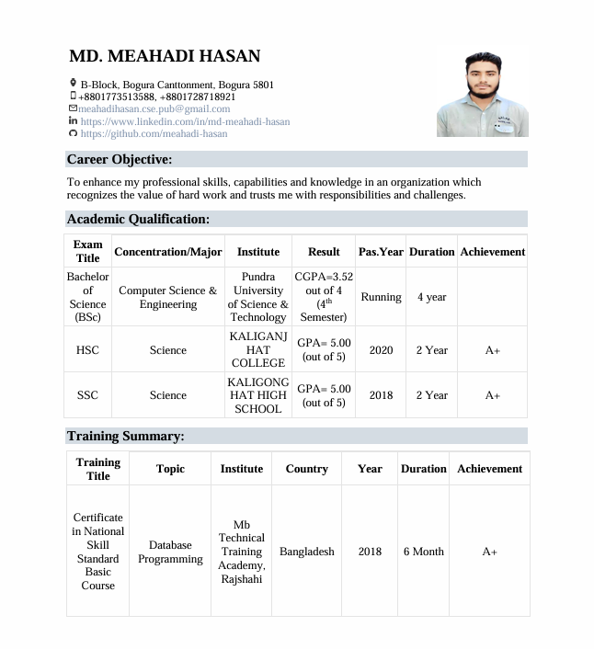
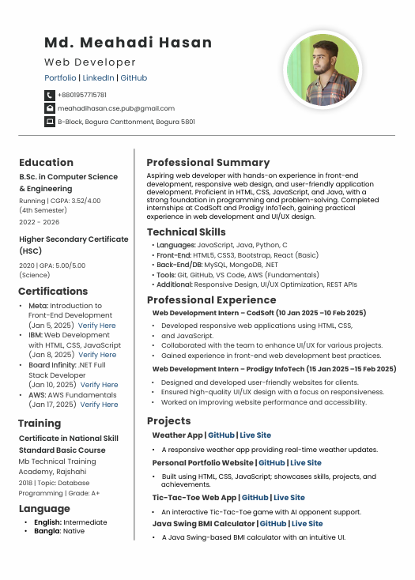
CV & Resume (With Screenshots & Links)
CV Screenshot:
Resume Screenshot:
See My CV
See My Resume

Slide 9
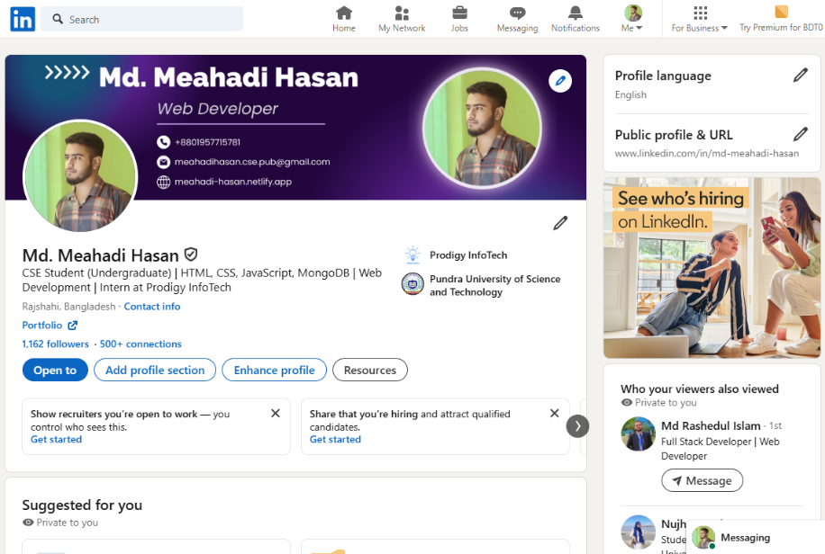
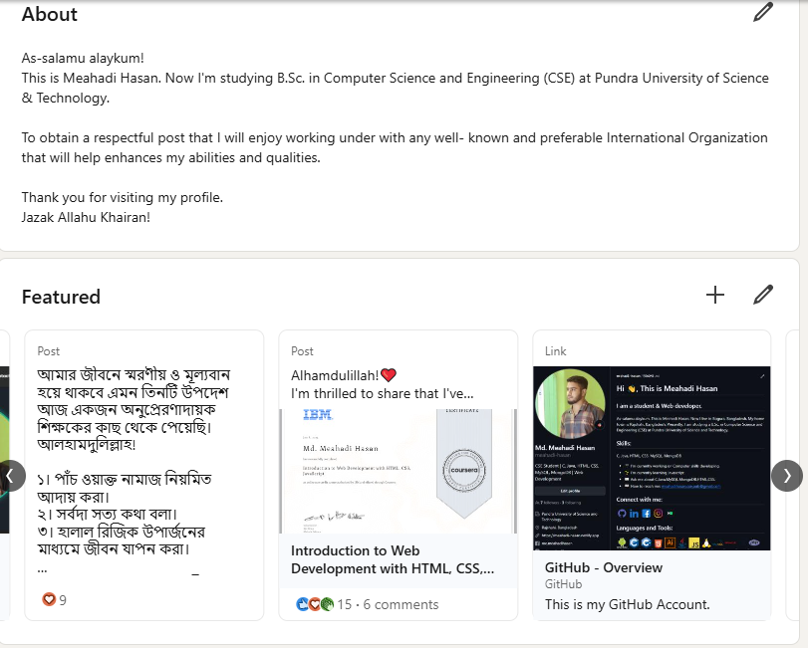
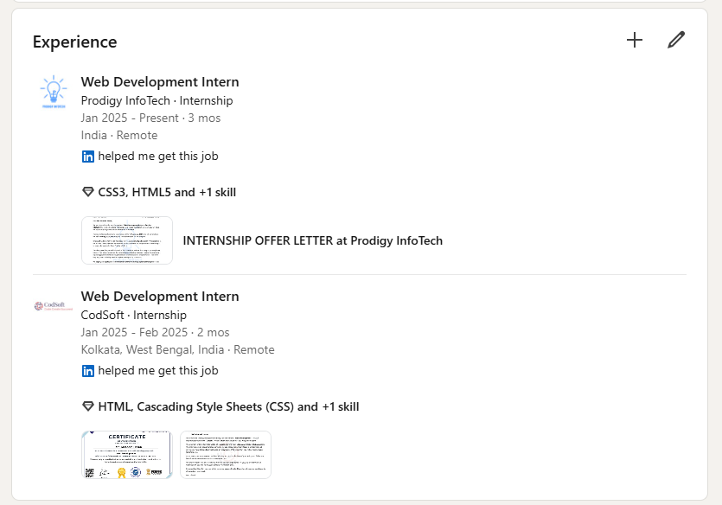
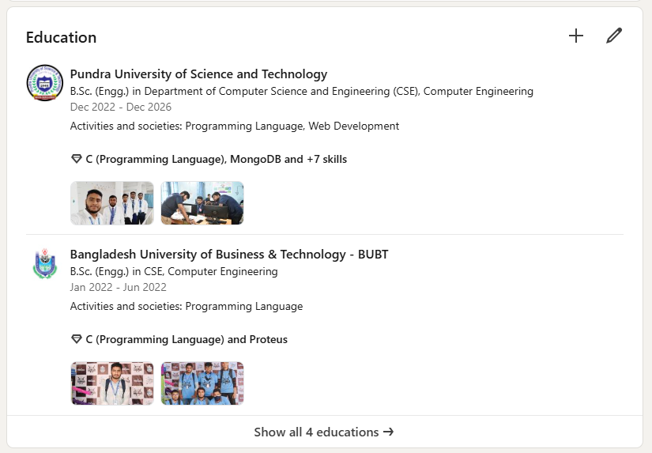
LinkedIn (With Screenshots & Links)

Slide 10
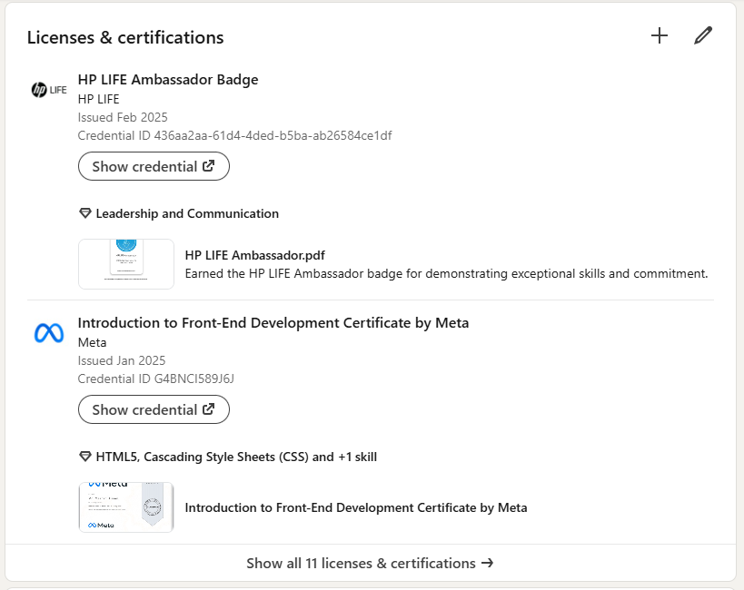
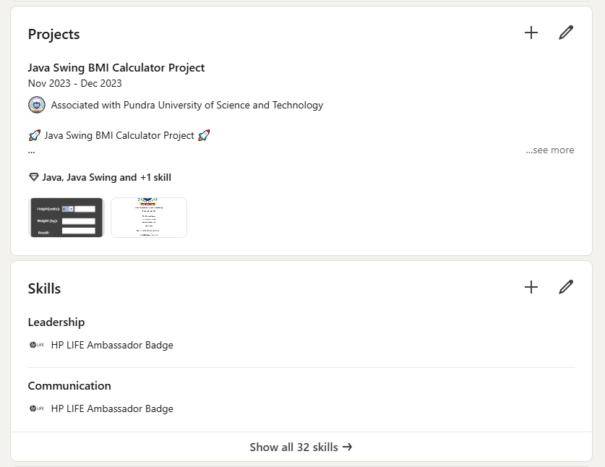
LinkedIn (With Screenshots & Links)
See My LinkedIn Profile

